Slide 1
DEEP LEARNING AND REINFORCEMENT LEARNING
Pima Diabetes Dataset
TING CHONG NA
30.05.2023

Slide 2
DATASET
Topic:
Pima Diabetes Dataset
Objective:
Compare and see how different network structures affect the performance, training time, and level of overfitting (or underfitting).
Dataset:
The UCI Pima Diabetes Dataset which has 8 numerical predictors and a binary outcome.
Use a neural network to predict diabetes using the Pima Diabetes Dataset.
y=0
do not have diabetes
y=1
have diabetes

Slide 3
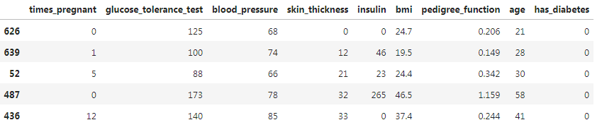
DATASET
768 observations
9
features
The features available from the dataset are:
Number of times pregnant
Plasma glucose concentration a 2 hours in an oral glucose tolerance test
Diastolic blood pressure (mm Hg)
Triceps skin fold thickness (mm)
2-Hour serum insulin (mu U/ml)
Body mass index (weight in kg/(height in m)^2)
Diabetes pedigree function
Age (years)
Class variable (0 or 1)

Slide 4
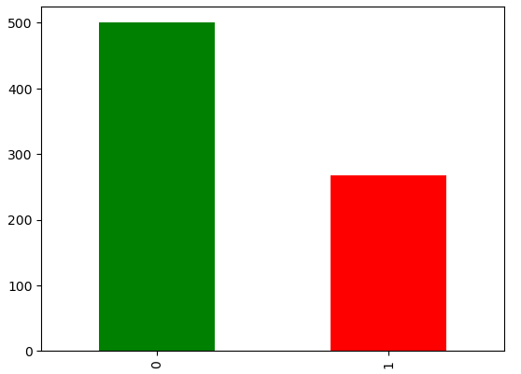
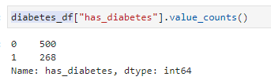
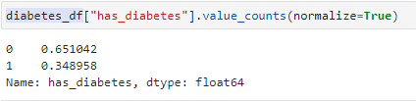
DATA ANALYSIS
For all Numeric variables
35% of the patients have diabetes, while 65% do not
We can get an accuracy of 65% without any model - just declare that no one has diabetes
Imbalanced Class

Slide 5
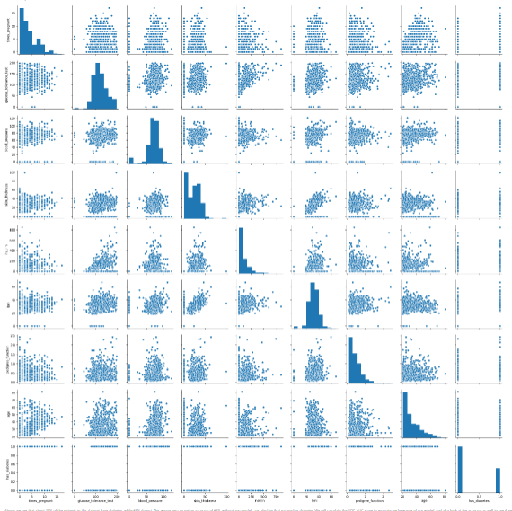
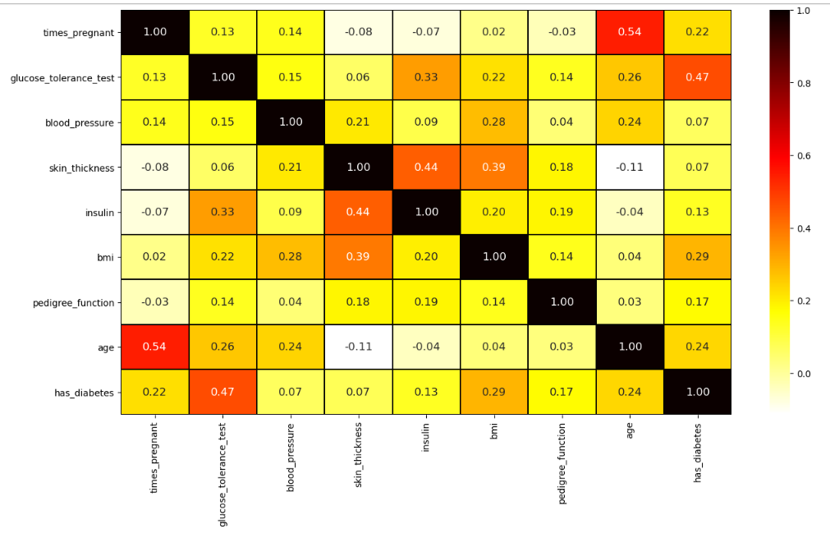
DATA ANALYSIS
For all Numeric variables
Perform Multivariate Analysis by creating a pairplot of all the columns
Using Heatmap to explore which variables are positively or negatively correlated with one another

Slide 6
DATA ANALYSIS
For all Numeric variables
Train Test Split
ROC-AUC score
Model
Split the data to Train and Test (75%, 25%)
to evaluate performance of our model
Random Forest
Single Hidden Layer Neural Network
Two Hidden Layer Neural Network

Slide 7
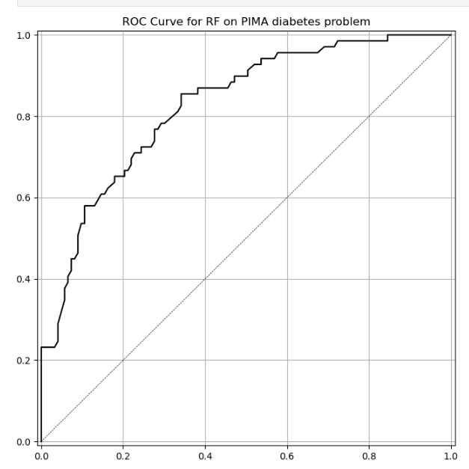


Model: Random Forest
Train a Random Forest model with 200 trees on the training data.
Random Forest
Accuracy:
0.766
ROC:
0.826
ROC CURVE

Slide 8
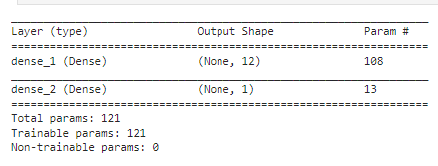
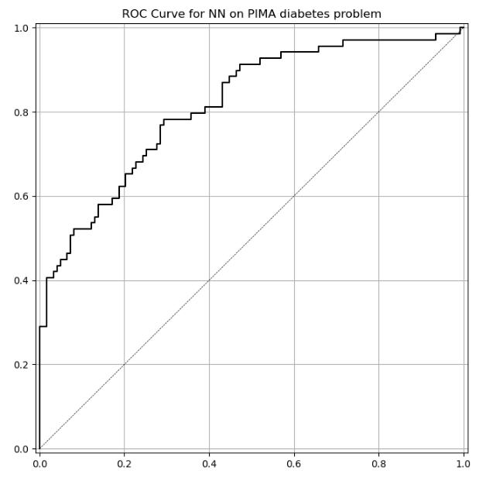
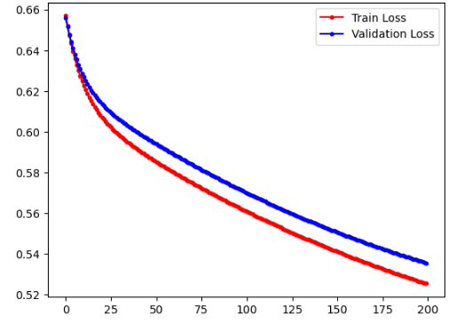

Model: Single Hidden Layer Neural Network
Build a Single Hidden Layer Neural Network with 200 epoches.
STANDARDSCALER
Providing Numerical Stability
SEQUENTIAL MODEL
Single Hidden Layer Neural Network
COMPILE MODEL
SGD(lr=.003),accuracy,
binary_crossentropy
ROC CURVE
Model Performance
Training Loss and Validation Loss
Sequential Model
ROC CURVE
Train Loss & Val Loss

Slide 9
Model: Compare results
Random Forest
Accuracy:
0.766
ROC:
0.826
Single Hidden Layer NN
Accuracy:
0.766
ROC:
0.816
In Single Hidden Layer Neural Network model
There are some variation in exact numbers due to randomness, but get results in the same ballpark as the Random Forest:
between 75% and 85% Accuracy
between 80%and 90% for ROC-AUC
The losses are still going down on both the training set and the validation set. This suggests that the model might benefit from further training.
NEXT: Train for 1000 more epochs.

Slide 10
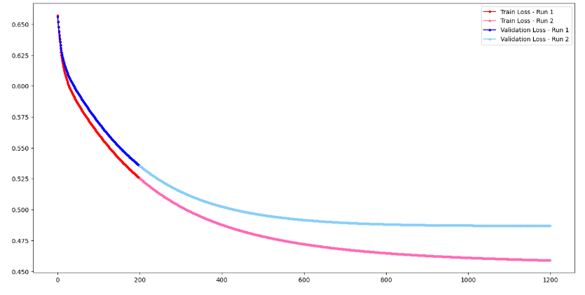
Model: Single Hidden Layer Neural Network
Train for 1000 more epochs.
While the training loss is still going down, it looks like the validation loss has stabilized (or even gotten worse!).
This suggests that our network will NOT benefit from further training.
Train Loss & Val Loss

Slide 11

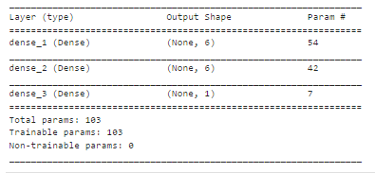

Model: 2 Hidden Layer Neural Network
Build 2 Hidden Layer Neural Network with 1500 epoches.
Sequential Model
ROC CURVE

Slide 12
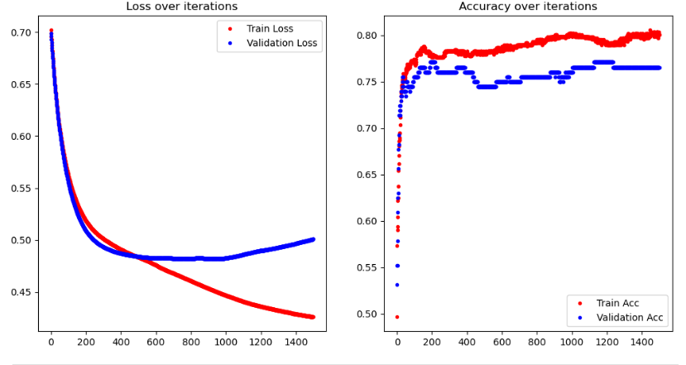
Model: 2 Hidden Layer Neural Network
Build 2 Hidden Layer Neural Network with 1500 epoches.
Loss and Accuracy

Slide 13
Conclusion
Random Forest
Accuracy:
0.766
ROC:
0.826
Single Hidden Layer NN
Accuracy:
0.766
ROC:
0.816
Two Hidden Layer NN
Accuracy:
0.766
ROC:
0.810
In conclusion, Random Forest seems to be the best method as it has the Highest ROC-AUC values.

Slide 14
POSSIBLE FLAW IN MODEL
ROC-AUC metrics
ROC analysis uses True Positive Rate (TPR or Recall) and False Positive Rate (FPR)
Regularization Techniques
Add more regularization to model
Precision-Recall analysis exchanges FPR for Precision
While ROC uses all the cells (TP, FP, TN, FN) of the Confusion Matrix, Precision-Recall disregards the True Negatives, which have a high impact on an imbalanced problem
Precision-Recall gives more weight to the minority class (the positive class) than the ROC, so Precision-Recall is more suitable for this dataset which has imbalanced problems
L2 (Ridge) regularization, L1 (Lasso) regularization, Dropout, Batch Normalization, Data shuffling

